Slide 1
CrossFS: A Cross-layered Direct-Access File System
Yujie Ren, Changwoo Min, Sudarsun Kannan
In 2020 USENIX Symposium on Operating Systems Design and Implementation
2021. 02. 02
Presentation by Inho, Song
inhoinno@dankook.ac.kr
Notes:
Let me begin my presentation.
Today I will give a presentation on “Fully Automatic Stream Management for Multi-Streamed SSDs Using Program Contexts”

Slide 2
Background & Introduction
Motivation
Evaluation(1/2)
Design
Evaluation(2/2)
Conclusion
Notes:
This is the outline on my talk.
First, I will describe garbage Collection overhead in SSDs and Multi-Streamed SSD
Then, the details of PCStream design and analysis results are presented.
Finally, I will conclude my talk.

Slide 3


1. Background & Introduction
Three Main Bottleneck
Thread A
Thread B
write(shared_file, Block 2)
write(shared_file, Block N)
1.
High Software overheads
(system call for performing I/O, 1-4μs)
2.
Non-scalable concurrent access
when accessing disjoint block
(e.g. inode-level rw lock)
inode
4k
…
Shared file
Block 1
Block N
General File System

Slide 4
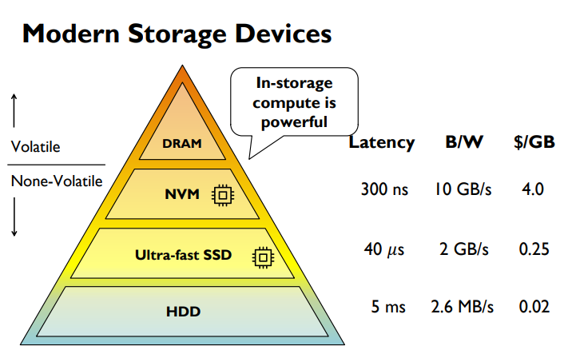
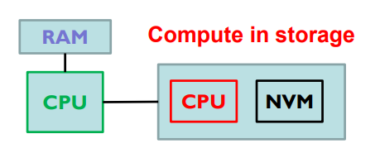
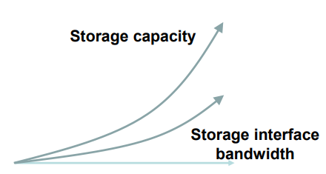
1. Background & Introduction
Trend of Modern Storage Devices
In storage computing, The choice of implementation today*
3.
Lack support for leveraging host and device-level compute
(Host CPU are fast, but low utilization for processing I/O request )
*A Comparison of In-Storage Processing Architectures and Technologies, Jérôme Gaysse, 2018 SDC

Slide 5

2. Motivation
Poor concurrent access scalability
Lack of synergistic design : combined use of host and device resource
Inode-centric design limit
Applications must ‘trap’ into an OS
Ext4-DAX
Strata
DevFS
Notes:
NVM은 DRAM보다 용량이 크고 storage보다 속도가 빠르다. 영구적인 데이터를 접근할 때 메모리에 접근할 때처럼 byte단위로 접근이 가능하다 그래서 메모리와 스토리지 간의 페이지 블록 단위의 접근을 없앨 수 있다.

Slide 6
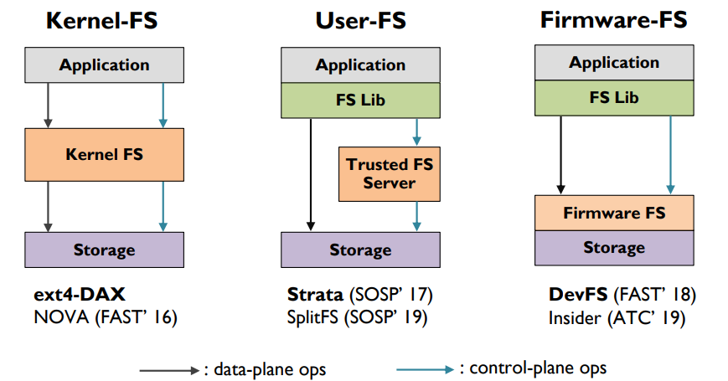
2. Motivation
Doesn’t exploit powerful host CPU at all
System call,trap …
Notes:
NVM은 DRAM보다 용량이 크고 storage보다 속도가 빠르다. 영구적인 데이터를 접근할 때 메모리에 접근할 때처럼 byte단위로 접근이 가능하다 그래서 메모리와 스토리지 간의 페이지 블록 단위의 접근을 없앨 수 있다.

Slide 7
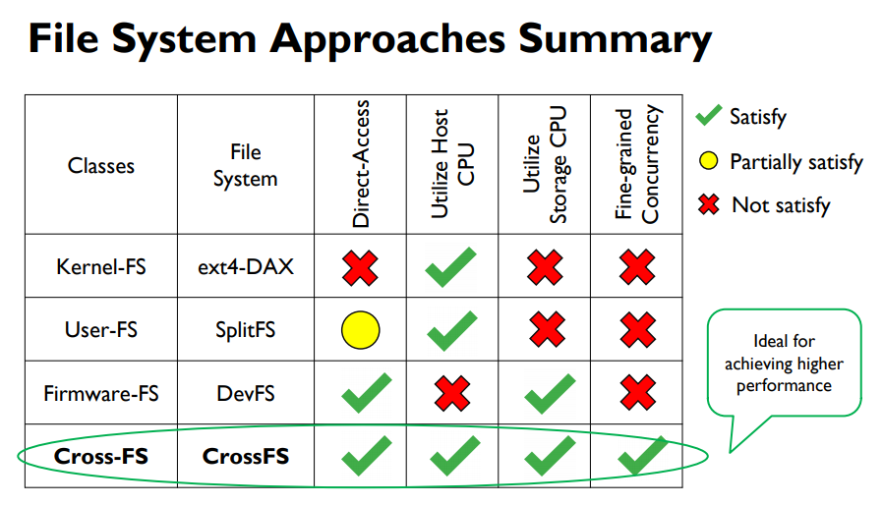
2. Motivation
Notes:
NVM은 DRAM보다 용량이 크고 storage보다 속도가 빠르다. 영구적인 데이터를 접근할 때 메모리에 접근할 때처럼 byte단위로 접근이 가능하다 그래서 메모리와 스토리지 간의 페이지 블록 단위의 접근을 없앨 수 있다.

Slide 8
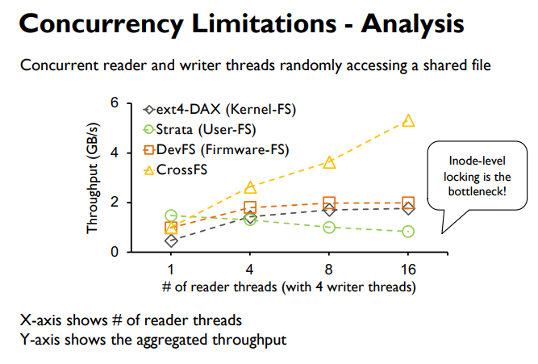
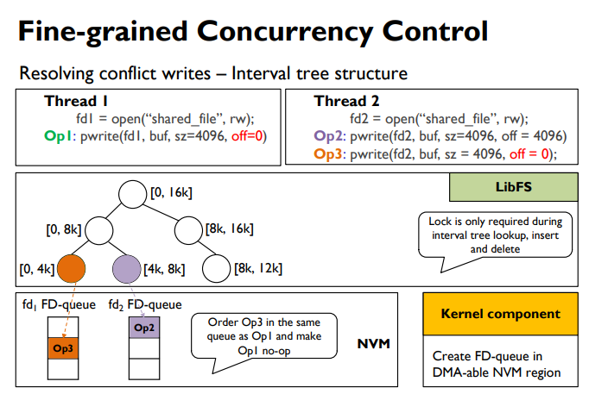
Designs a synergistic design across the user, the kernel, and the firmware layers
How much improvement?
How to design FS ?
Notes:
DRAM과 PCM, NAND간의 속도차이가 몇배가 나는지 설명

Slide 9
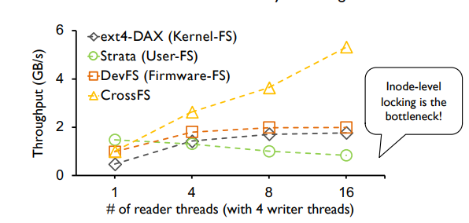
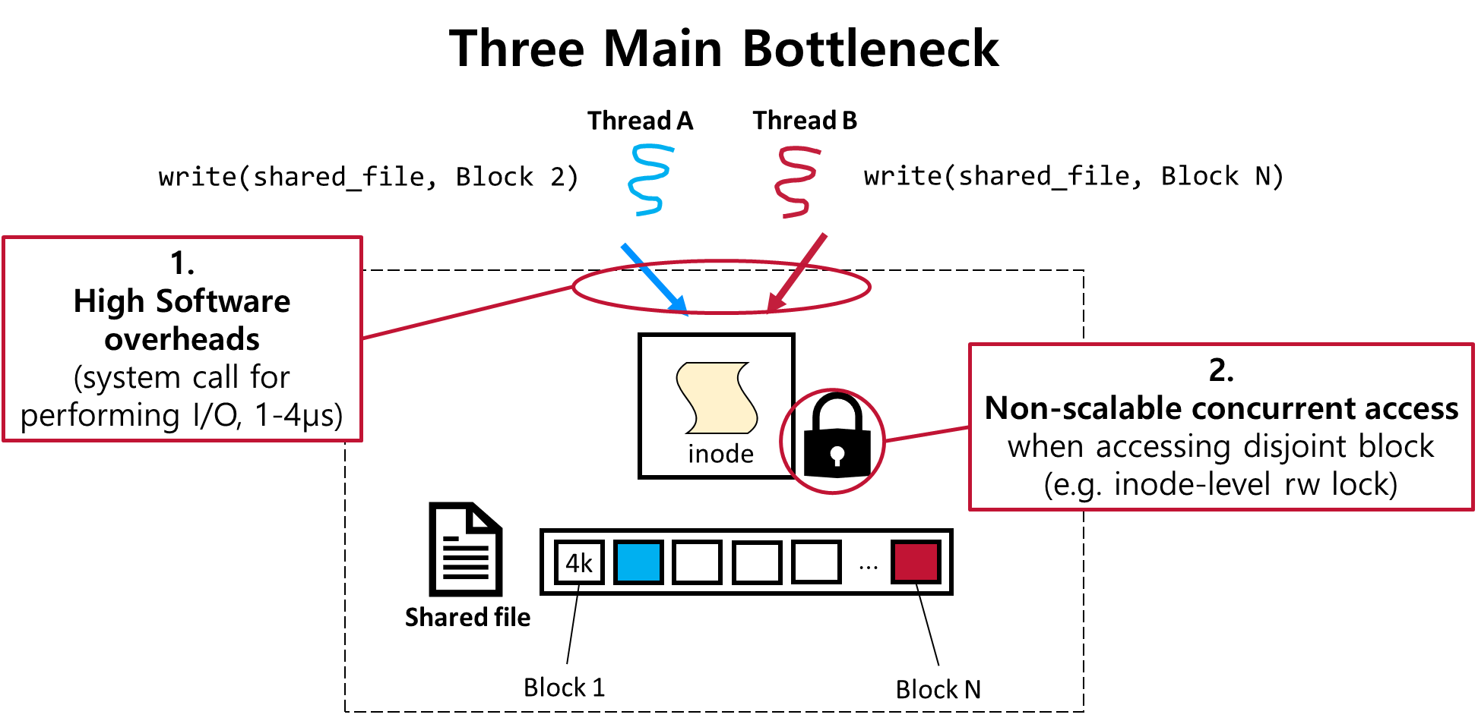
3. Evaluation (1/2)
Concurrent Read Throughput
Sharing across Reader and Writer Threads
Ext4-DAX, Strata, DevFS,
→ The read performance does not scale even when accessing disjoint blocks, mainly due to inode-level rw-lock
Aggregated read throughput when there are 4-concurrent writter
Notes:
DRAM과 PCM, NAND간의 속도차이가 몇배가 나는지 설명

Slide 10
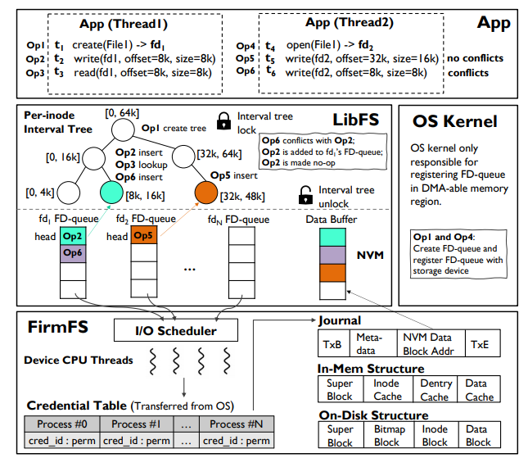
4. Design
CrossFS Design
= LibFS + OS Kernel + FirmFS
A Cross-layered direct-access file system
For achieving high performance direct-I/O, disaggregate file system(user, kernel, Firmware) to exploit host and device-level computing capabilities
Notes:
DRAM과 PCM, NAND간의 속도차이가 몇배가 나는지 설명

Slide 11
4. Design
CrossFS Design
= LibFS + OS Kernel + FirmFS
A Cross-layered direct-access file system
OS-bypass for data-plane and control-plane operations
POSIX I/O call → LibFS → FirmFS I/O commands
Notes:
DRAM과 PCM, NAND간의 속도차이가 몇배가 나는지 설명

Slide 12
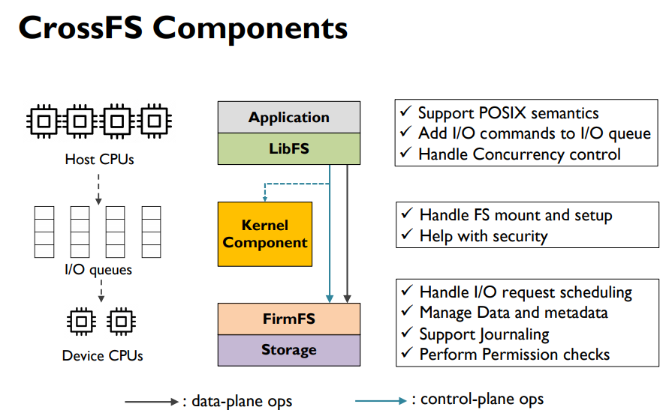
4. Design
OS-bypass for data-plane and control-plane operations
A Cross-layered direct-access file system
Notes:
DRAM과 PCM, NAND간의 속도차이가 몇배가 나는지 설명

Slide 13
4. Design
CrossFS Design
= LibFS + OS Kernel + FirmFS
A Cross-layered direct-access file system
File descriptor-based fine-grained concurrency control
Notes:
DRAM과 PCM, NAND간의 속도차이가 몇배가 나는지 설명

Slide 14
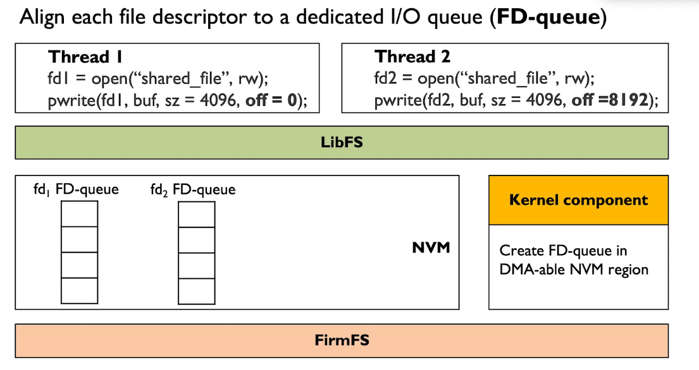


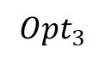
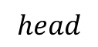
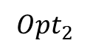
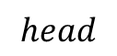
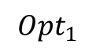
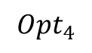
4. Design
File descriptor-based fine-grained concurrency control
File descriptor : A fundamental unit of synchronization (→ FD-queue)
$$Opt_{1}$$
$$Opt_{3}$$
$$Opt_{2}$$
$$Opt_{4}$$
$$head$$
1
$$head$$
2
Notes:
DRAM과 PCM, NAND간의 속도차이가 몇배가 나는지 설명

Slide 15
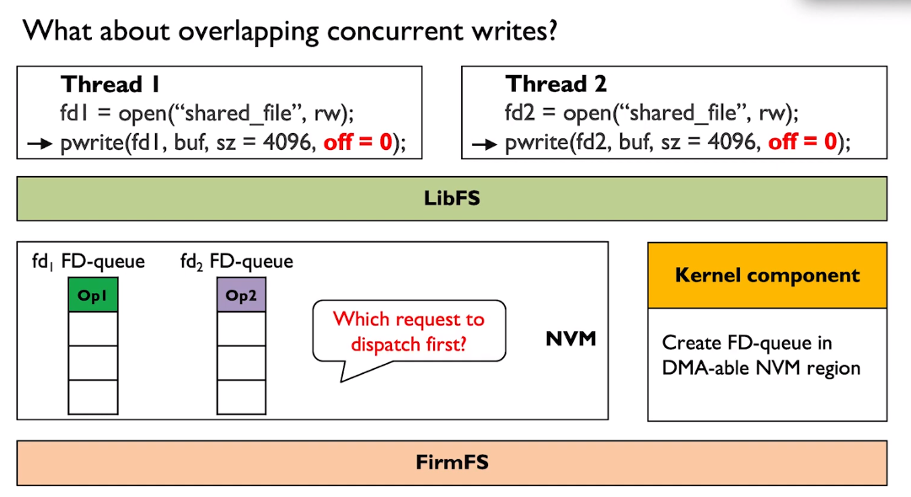

4. Design
File descriptor-based fine-grained concurrency control
Then, what is going on at
Overlapping block?
Notes:
DRAM과 PCM, NAND간의 속도차이가 몇배가 나는지 설명

Slide 16
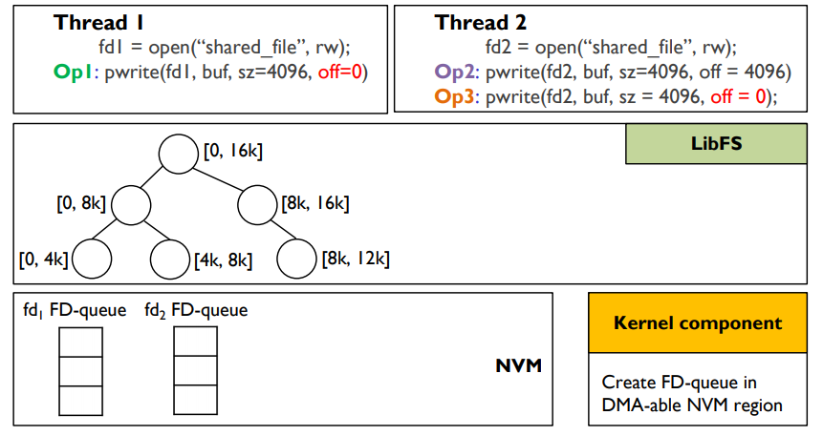


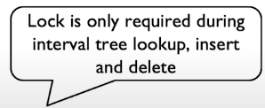
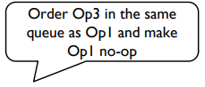
4. Design
File descriptor-based fine-grained concurrency control
Interval tree data structure : resolving overlapping writes with RB-tree
1
2
3
Notes:
DRAM과 PCM, NAND간의 속도차이가 몇배가 나는지 설명

Slide 17
4. Design
CrossFS Design
= LibFS + OS Kernel + FirmFS
A Cross-layered direct-access file system
Firmware-level file descriptor’s I/O queue scheduling
Notes:
DRAM과 PCM, NAND간의 속도차이가 몇배가 나는지 설명

Slide 18
4. Design
Firmware-level file descriptor’s I/O queue scheduling
I/O Scheduling Policies
Round Robin
(Pros) Provides fairness , (Cons) Delays blocking operations(fsync)
Urgent Aware Scheduling
→ Prioritize blocking requests
Avoids write request starvation
More sophisticated policies → Future Work!
Notes:
DRAM과 PCM, NAND간의 속도차이가 몇배가 나는지 설명

Slide 19
4. Design
CrossFS Design
= LibFS + OS Kernel + FirmFS
A Cross-layered direct-access file system
Cross-layered crash consistency → NVMs
Notes:
DRAM과 PCM, NAND간의 속도차이가 몇배가 나는지 설명

Slide 20
4. Design
Cross-layered crash consistency → NVMs
FD-queue Crash Consistency
NVM provides persistence
CLWB and memory fence to provide crash consistency
(In the absence of NVM, CrossFS uses DRAM for FD-queues, providing the guarantees of traditional kernel FS)
Low-overhead FirmFS Crash Consistency
Data journaling is expensive
However, CrossFS, I/O request and data are buffered in FD-queue buffer
In journal entry, there is an offset of data buffer in NVM
Meaning of “Low-overhead” , “lightweight journaling” :
Get data journaling benefits at the cost of metadata journaling
Notes:
DRAM과 PCM, NAND간의 속도차이가 몇배가 나는지 설명

Slide 21

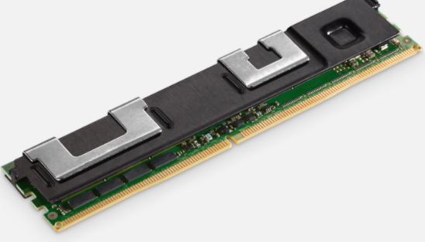
5. Evaluation
CrossFS: Evaluation Metric
How effective is CrossFS in exploiting the cross-layered design and FD-based concurrency?
Can CrossFS’ cross-layered design scale for metadata intensive workloads with no data sharing across threads?
Does CrossFS benefit real-world applications?(RocksDB)
[Appendix]What is the impact of host configuration such as storage bandwidth, device-CPU frequency, and PCIe latency?
[Appendix] How effective is CrossFS’ FD-queue scheduler?
Experimental Setup
Host |  | 2.7GHz Intel(R) Xeon(R) Gold, dual-socket, 64-core with 32GB memory & 512 SSD
NVM |  | 512GB Intel Optane DC NVM (4x128GB)
State-of-the-art File Systems
KernelFS | Ext4-DAX | Kernel-level file system
 | NOVA | FAST ’16
UserFS | Strata | SOSP ’17
 | SplitFS | SOSP ’19
Firmware | DevFS | FAST ‘18
Notes:
DRAM과 PCM, NAND간의 속도차이가 몇배가 나는지 설명

Slide 22
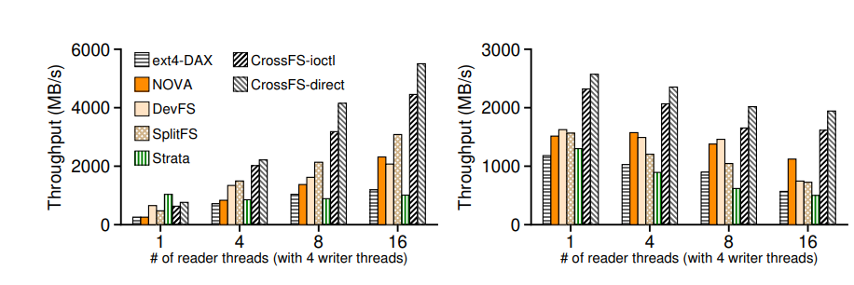
4. Design
How effective is CrossFS in exploiting the cross-layered design and FD-based concurrency?
Concurrent accesses scaling when sharing files
Microbenchmark
Read scalability
Write scalability
3.41x
☆Readers do not have to wait for writers
☆Non-overlapping writes dispatched in parrallel
Notes:
DRAM과 PCM, NAND간의 속도차이가 몇배가 나는지 설명

Slide 23
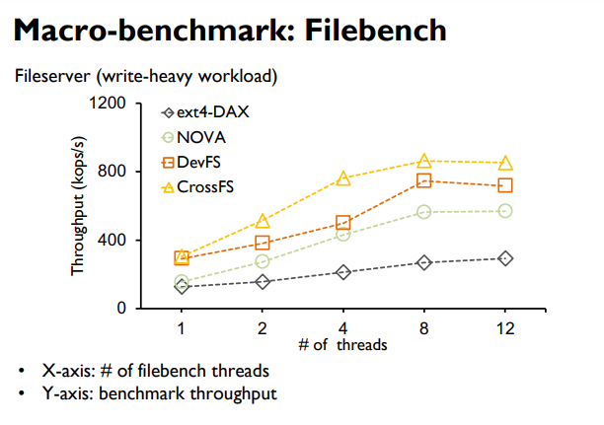
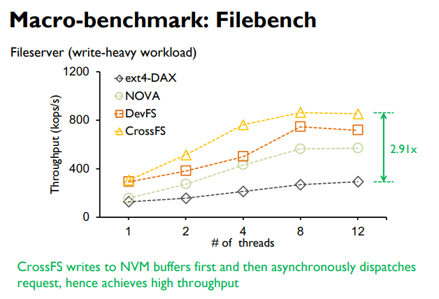
4. Design
Can CrossFS’ cross-layered design scale for metadata intensive workloads with no data sharing across threads?
*write-heavy : metadata-intensive workloads such as file create, delete, directory update
Notes:
DRAM과 PCM, NAND간의 속도차이가 몇배가 나는지 설명

Slide 24
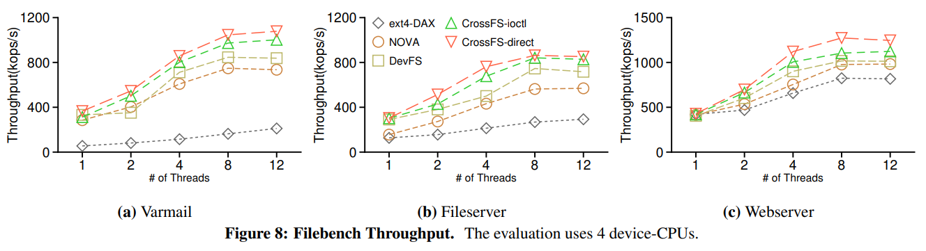
4. Design
Can CrossFS’ cross-layered design scale for metadata intensive workloads with no data sharing across threads?
*metadata-heavy
*write-heavy
*read-heavy
Notes:
DRAM과 PCM, NAND간의 속도차이가 몇배가 나는지 설명

Slide 25
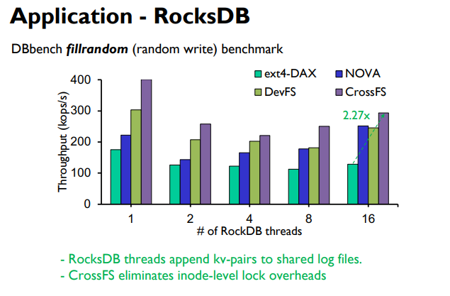
4. Design
Does CrossFS benefit real-world applications?(RocksDB)
Notes:
DRAM과 PCM, NAND간의 속도차이가 몇배가 나는지 설명

Slide 26
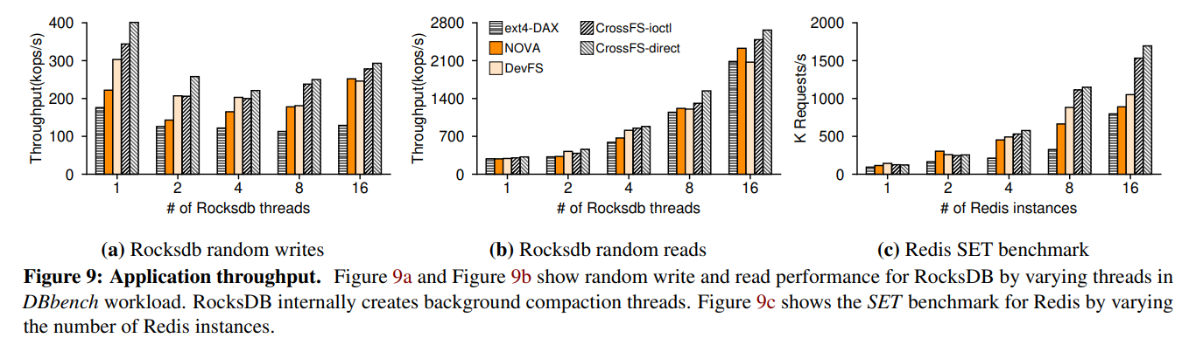
4. Design
Does CrossFS benefit real-world applications?(RocksDB)
Notes:
DRAM과 PCM, NAND간의 속도차이가 몇배가 나는지 설명

Slide 27
6. Conclusion
CrossFS
Storage hardware (with compute capability) has reached the microsecond era
Providing direct I/O and utilizing host and storage-level compute is critical
CrossFS approach : Cross-layered storage file system design
Fine grained concurrency control is important for I/O scalability
CrossFS approach : File-descriptor concurrency control
(Future Work) : H/W integration, support sophisticated scheduling policies, other FS operations(e.g. mmap())

Slide 28
CrossFS: A Cross-layered Direct-Access File System
Yujie Ren, Changwoo Min, Sudarsun Kannan
In 2020 USENIX Symposium on Operating Systems Design and Implementation
Thank You!
2021. 02. 02
Presentation by Inho, Song
inhoinno@dankook.ac.kr
Notes:
Let me begin my presentation.
Today I will give a presentation on “Fully Automatic Stream Management for Multi-Streamed SSDs Using Program Contexts”

Slide 29
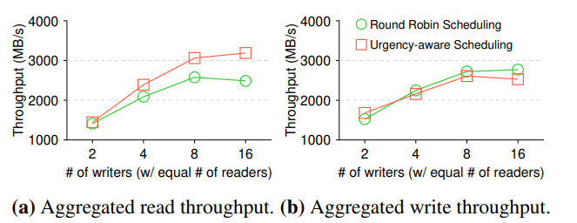
Appendix. 5. Evaluation
How effective is CrossFS’ FD-queue scheduler?
Notes:
DRAM과 PCM, NAND간의 속도차이가 몇배가 나는지 설명

Slide 30
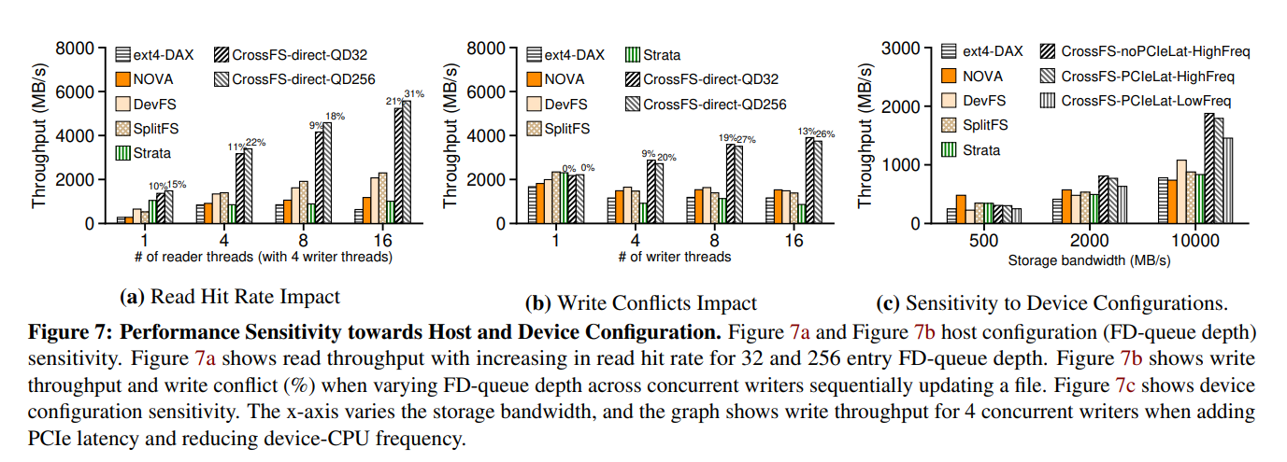
Appendix. 5. Evaluation
What is the impact of host configuration such as storage bandwidth, device-CPU frequency, and PCIe latency?
Notes:
DRAM과 PCM, NAND간의 속도차이가 몇배가 나는지 설명

